Slide 1

Note: The data and information in this document is reflective of a hypothetical situation and client. This document is to be used for KPMG Virtual Internship purposes only.
Sprocket Central Pty Ltd
Data Insights and Future Approach
[Division Name] - [Engagement Manager], [Senior Consultant], [Junior Consultant]

Slide 2
Note: The data and information in this document is reflective of a hypothetical situation and client. This document is to be used for KPMG Virtual Internship purposes only.
Trend and Future Approach
Trends:
Mass customer segment significantly earns the highest total profit for the client.
Affluent customers have the highest average profit per customer.
Client earns the highest profit from the Financial services and manufacturing industries.
Observation:
Customers who work in financial services, own a car and belong to the mass customer segment brings the highest value to the client.

Slide 3
Note: The data and information in this document is reflective of a hypothetical situation and client. This document is to be used for KPMG Virtual Internship purposes only.
Marketing and Growth Strategy
Client should target customers with the following demographic characteristics:
All the customers in the financial services industry.
Mass customers in the health industry.
Affluent customers who own a car, working in the manufacturing industry.
Mass customers in the manufacturing industry.

Slide 4
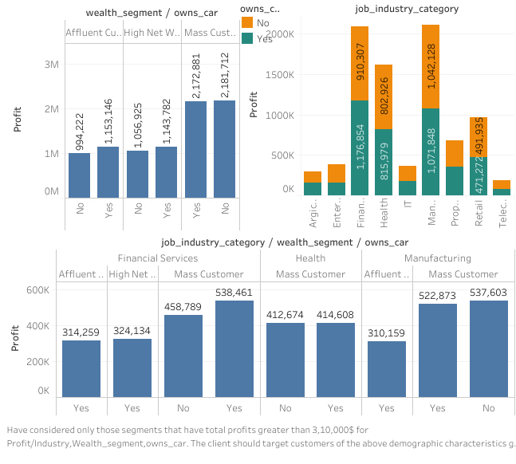
Click on the following link to view interactive Dashboard

Slide 5
Note: The data and information in this document is reflective of a hypothetical situation and client. This document is to be used for KPMG Virtual Internship purposes only.
Thank You!

